Slide 1
Research Computing Update
March 2020

Slide 2
HPC Resources
MI HPC Cluster
Have successfully moved critical HPC services to supported hardware.
Have carried out re-registration process for all HPC users. This was to remove inactive accounts, as well as to collect project and PI information from users.
Initiated purchase process to renew support for h/w which was cancelled at end of 2019.
SAN HPC
Have started procurement process to renew onsite engineer contract, using RC computing funds.
New HPC Procurement via ANKABUT
Still in process.

Slide 3
Training
“Introduction to Linux” course developed and delivered
Successfully delivered course, which includes students, faculty and researchers.
Course was well received and well attended.
Course is a prerequisite to existing “Intro to HPC”
“Introduction to HPC” course delivered
Developed an short, approximately 1 hour course to HPC with intention of making it a prerequisite to getting an account on HPC. This has been delivered multiple times and is proving very useful. Attendance to this session is now required, before new accounts are issued.

Slide 4
Resource Utilization

Slide 5
MI Cluster core distribution
MI HPC Cluster migration
As part of migrating critical HPC management services from old unsupported hardware, to supported hardware the number of nodes available to users varied from day to day.
From 2nd to 14th of March, the number of nodes on the “old” cluster was gradually decreased, as they were added to the ”migrated” cluster. The following utilization stats take this into account.
Special allocation
A user in Nuclear Department had an important deadline, so we allocation 12 nodes for his exclusive use for 2 weeks. This allowed him to meet his deadline.

Slide 6
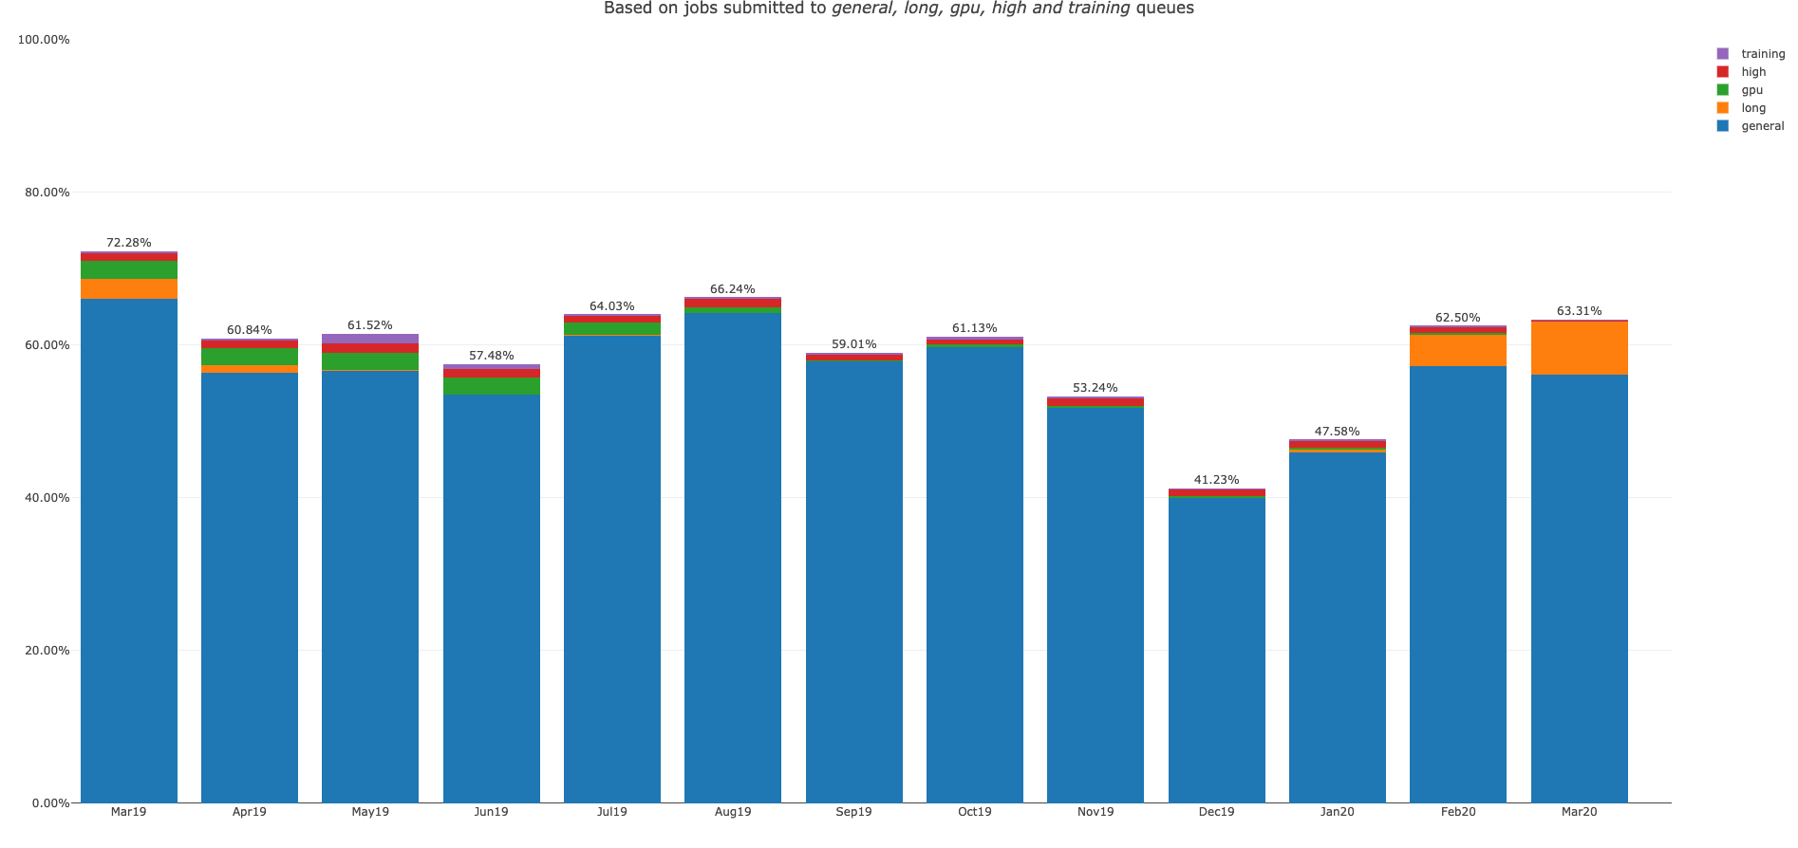
MI HPC – “Old” Cluster utilization report from Mar 19 to Mar 20

Slide 7
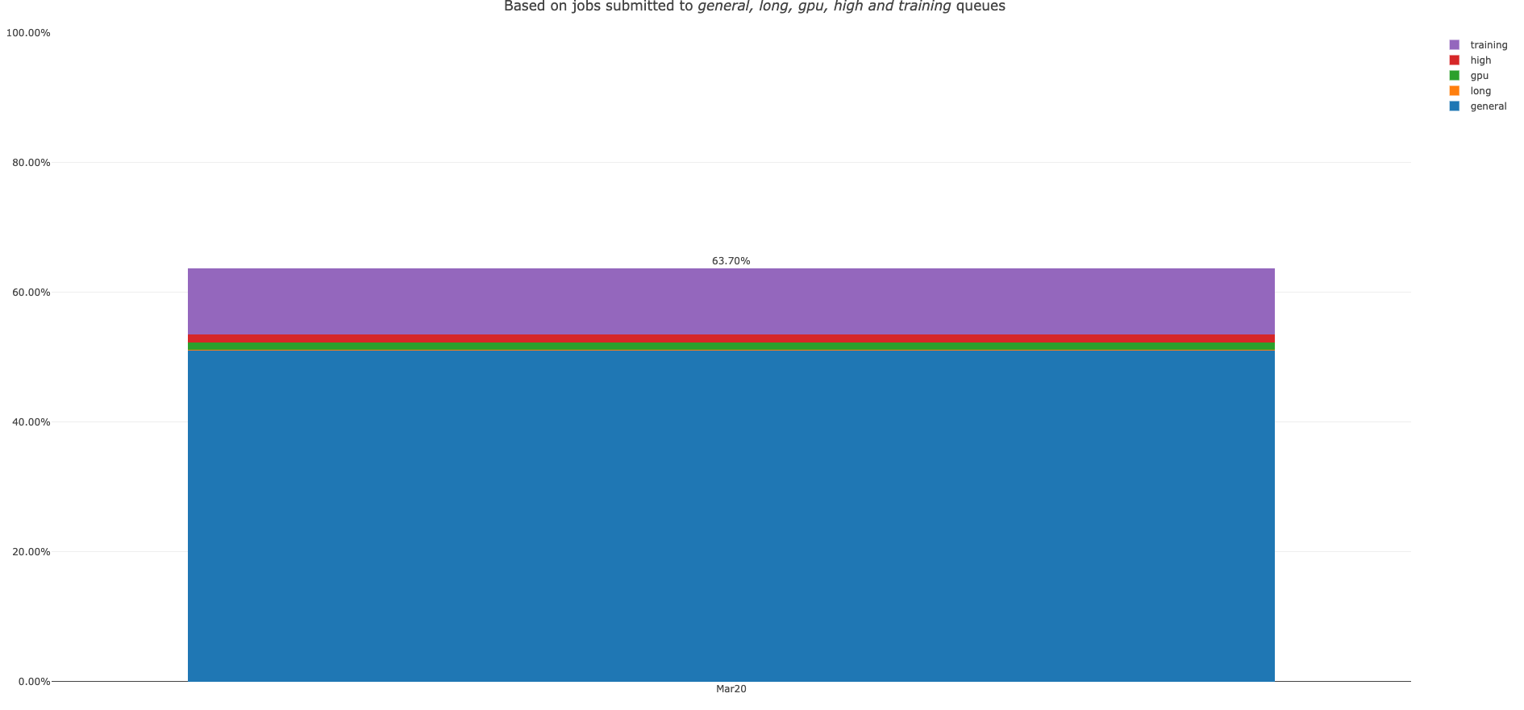
MI HPC – “migrated” Cluster utilization report for Mar20

Slide 8
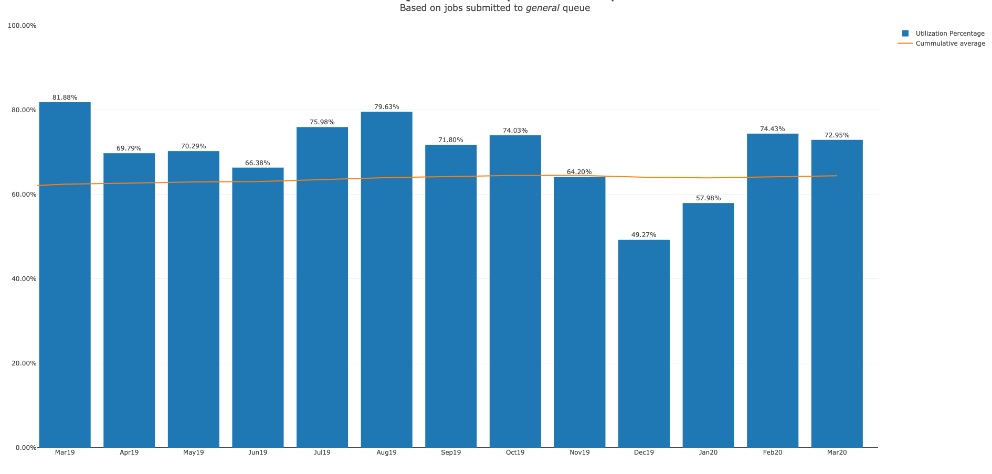
MI HPC – “Old” queues utilization report from Mar 19 to Mar 20

Slide 9
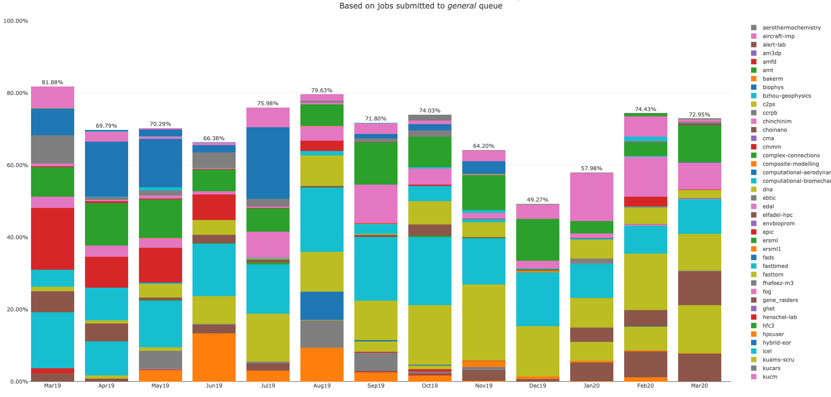
MI HPC – “Old” Group utilization report from Mar 19 to Mar 20

Slide 10
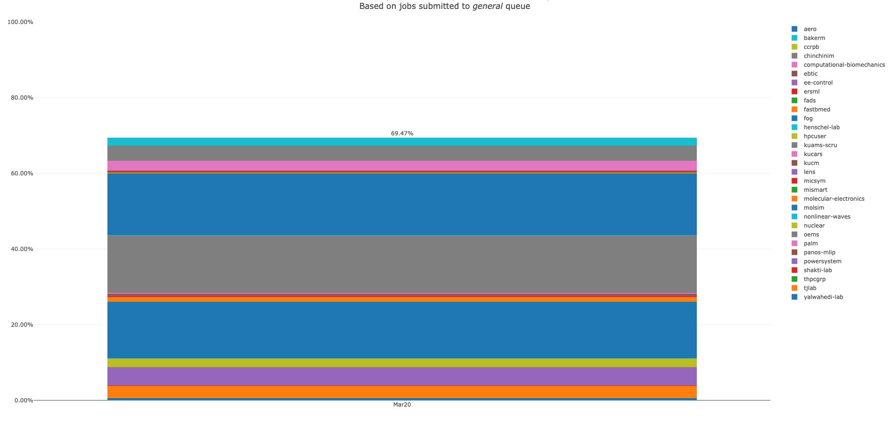
MI HPC – “Migrated” Group utilization report for Mar 20

Slide 11
MI HPC “old” - Group Utilization for March 2020

Slide 12
MI HPC “migrated” - Group Utilization for March 2020

Slide 13
PI Cluster core distribution

Slide 14
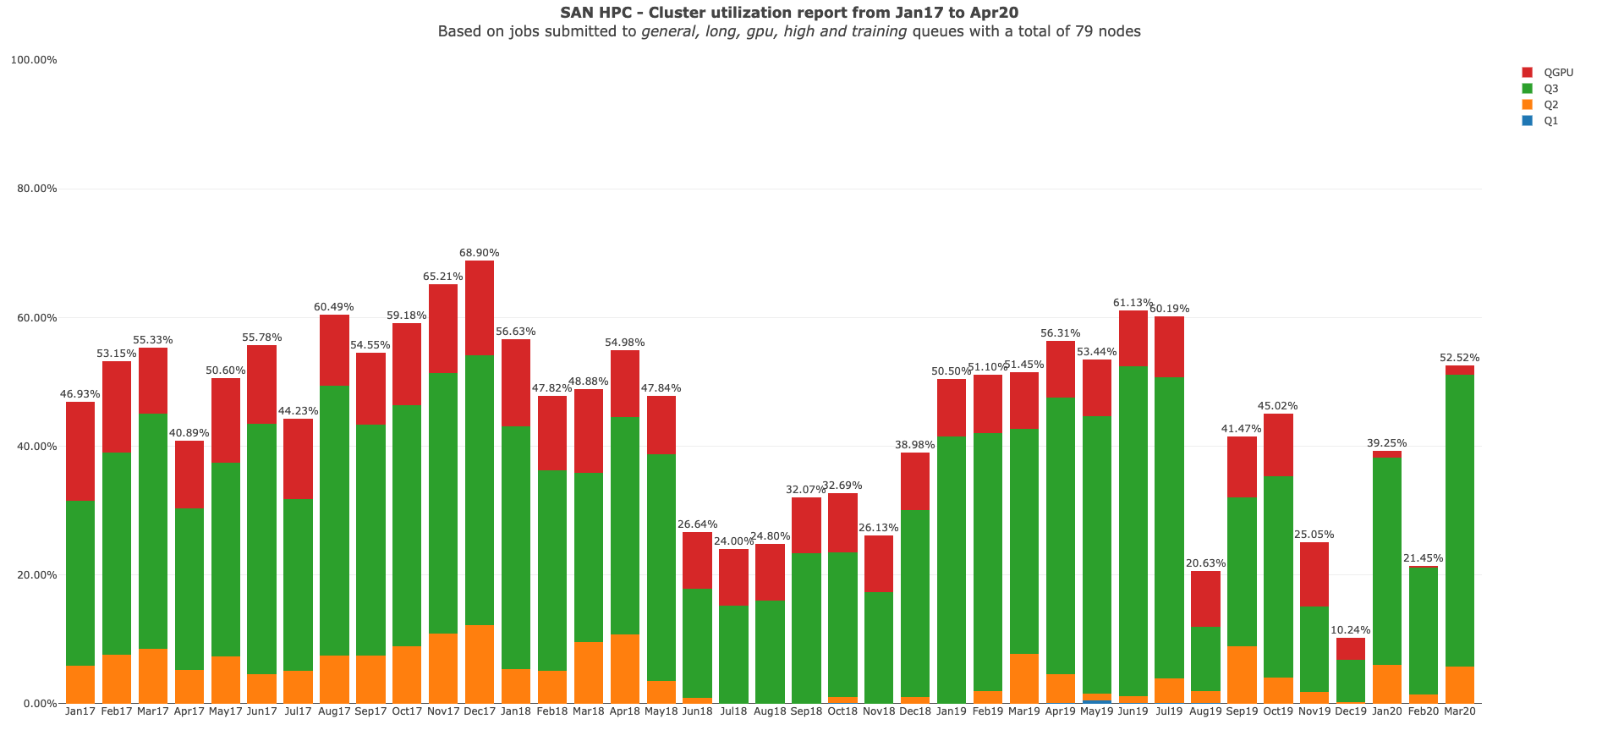

Slide 15
Status of KPI’s

